Slide 1
Physical anthropology of Azerbaijan (Antiquity period)
Kirichenko Dmitriy
PhD., Associate Professor
The Centre of Anthropology
Institute of Archaeology and Anthropology
Azerbaijan National Academy of Sciences

Slide 2
Physical anthropology
Physical anthropology, branch of anthropology concerned with the origin, evolution, and diversity of people. Physical anthropologists work broadly on three major sets of problems: human and nonhuman primate evolution, human variation and its significance (race), and the biological bases of human behavior.
Craniometric studies of prehistoric skull and face bones have enabled anthropologists to trace the gradual changes that occurred in the size and shape of the human head.
Craniometry is the technique of measuring the bones of the skull. It is distinct from phrenology, the study of personality and character, and physiognomy, the study of facial features.
Physical anthropology is currently one of the most important scientific historical disciplines concerned with the ethnogenesis of the Azerbaijani people and the indigenous ethnic groups that inhabit our country.

Slide 3
Physical type
R.M. Gasimova notes in it that the physical type of Azerbaijanis was formed primarily by two Europid anthropological types:
1. The dolichocephalic, somewhat narrow-faced type with a straight nasal dorsum, stronger hair cover growth, and dark pigmentation is characteristic of Azerbaijanis in the Lesser Caucasus Range, southern and central regions of the country, as well as Muslim Tats, Kurds, and Budugs. Furthermore, elements of this type are found among the Talysh. The distinctive characteristics of this type give credibility to its classification as a Caspian anthropological type.
2. The brachycephalic type, with a tendency to be broad-faced and have slightly weaker hair cover growth and relatively light pigmentation predominates among the Azerbaijanis of the country’s northwestern and northeastern regions, as well as among the “Shahdag group” and the Udi people.
Anthropological studies on our country’s territory show that the modern anthropological types of Azerbaijan’s population correspond to the types of the country’s ancient population.

Slide 4
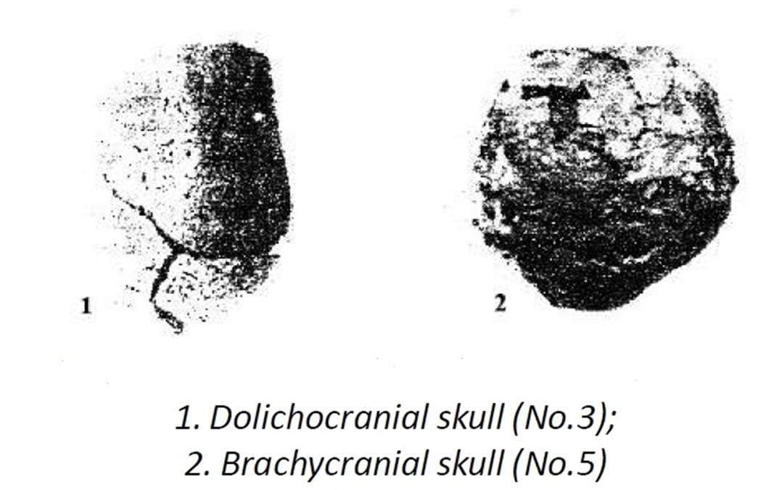
Skulls from Gobustan
Mesolithic period

Slide 5
Burial monuments of Azerbaijan – Caucasian Albania in antiquity period
By archaeological data, we know follow burial monuments: simple soil burials with skeletons in crouched (slight and strong) position, jar burials, catacomb burials, timber graves, stone boxes, burials in clay coffins, jar-catacomb burials, timber grave -catacombs, soil graves with skeleton in extended position, mud-brick tombs.
Catacomb burials belonged to nomads – Sarmatian-Alanian tribes, soil graves with skeleton in extended position to Mascut and Hunnic tribes, mud-brick tombs belonged to the migrants from Parthia.
Another’s burials belonged to autochthonic people of Caucasian Albania.

Slide 6
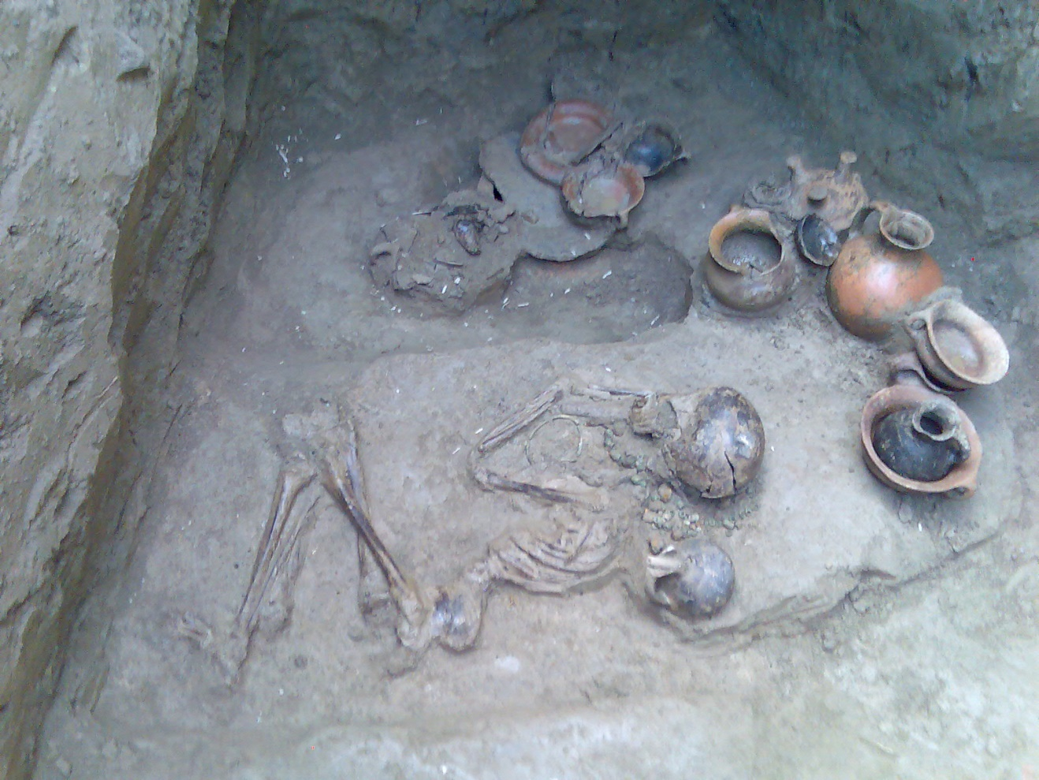
The simple Soil burials slight crouched position

Slide 7
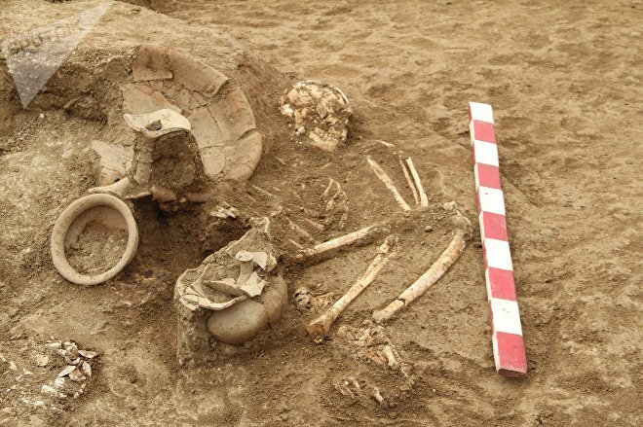
The simple soil burials strong crouched position

Slide 8
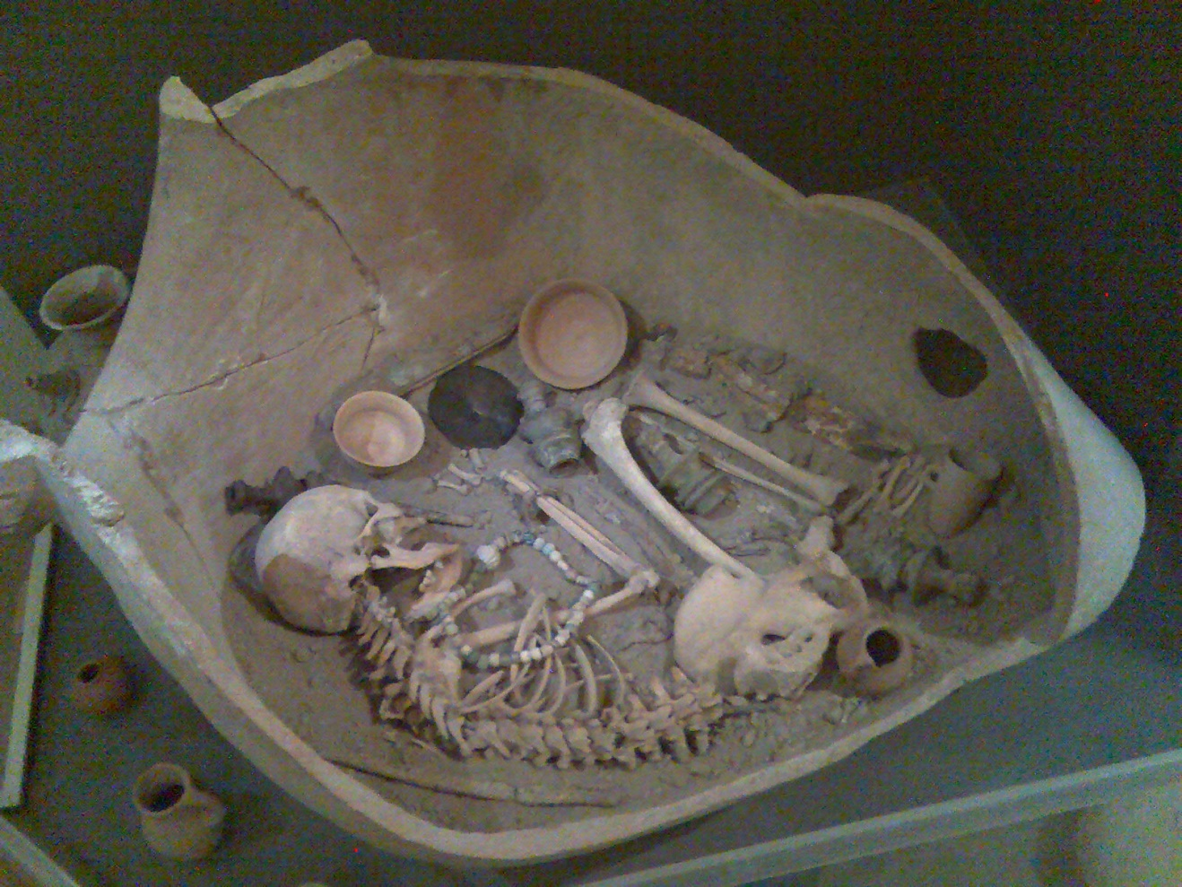
Jar burials

Slide 9
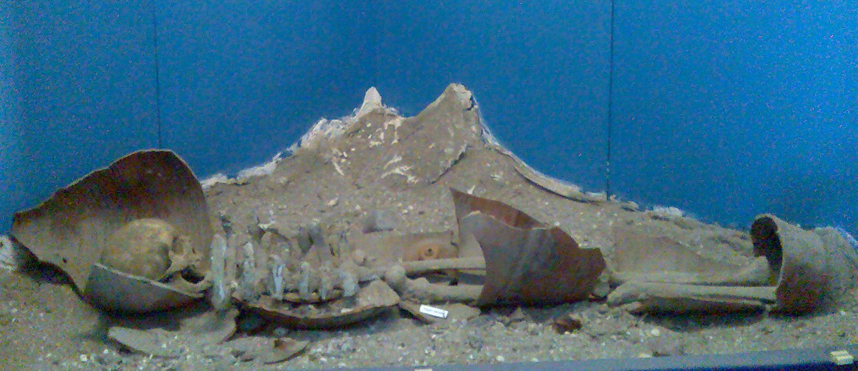
Jar burials

Slide 10
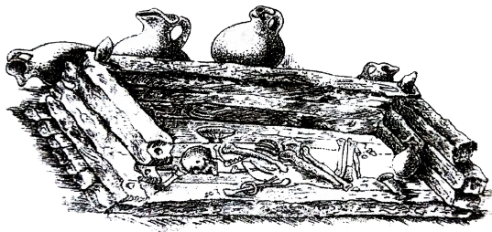
Timber graves

Slide 11
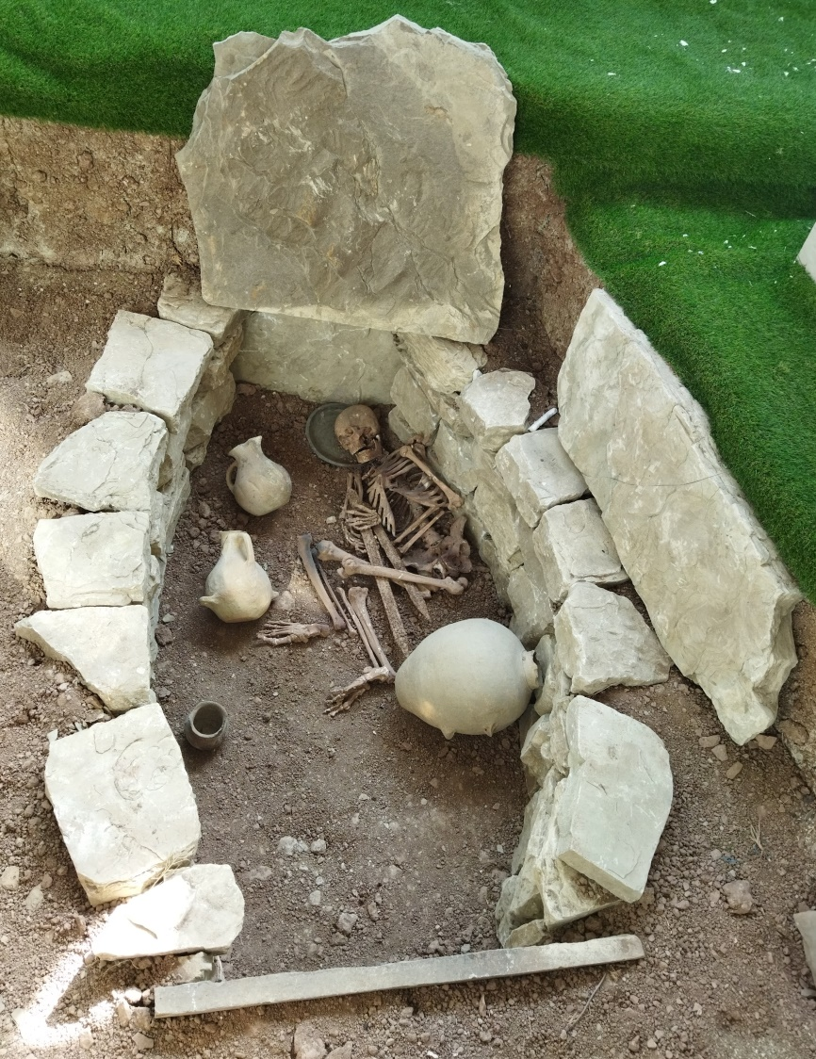
Stone boxes

Slide 12
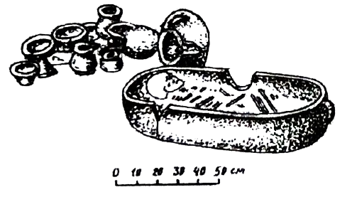
Burials in Clay coffins

Slide 13
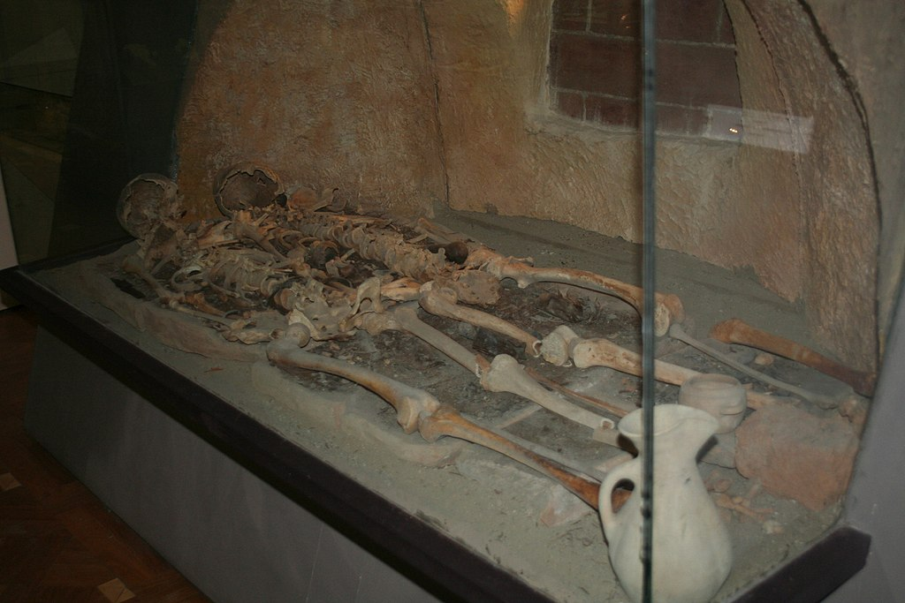
Catacomb burials

Slide 14
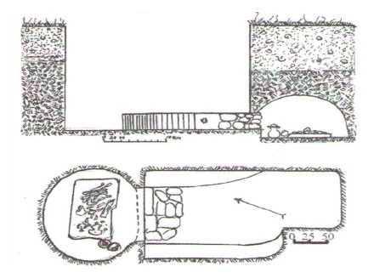

Slide 15
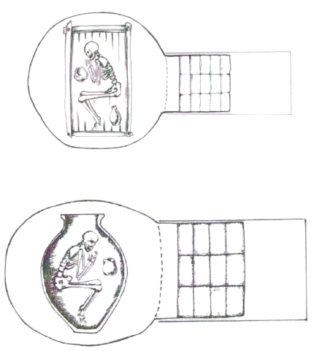
Timber grave-catacomb and jar-catacomb burials

Slide 16
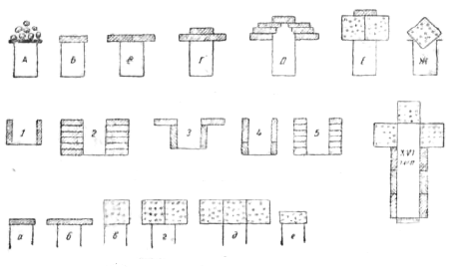
The mud-brick tombs

Slide 17
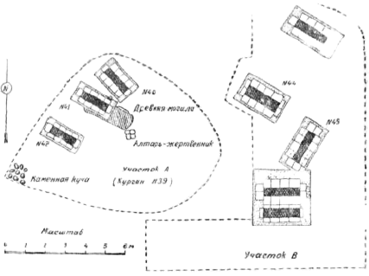

Slide 18
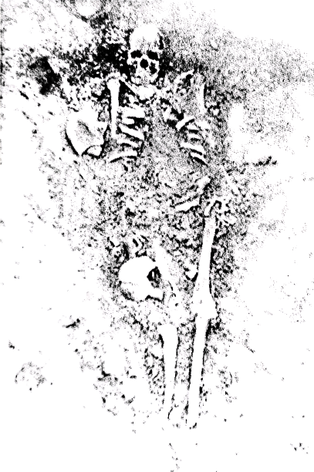
The soil burials in extended position

Slide 19
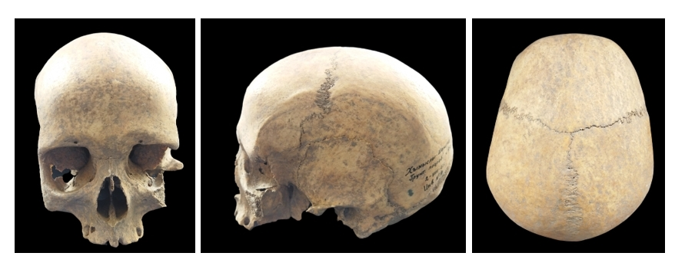
Skulls from simple soil burials
Khynysly necropolis

Slide 20
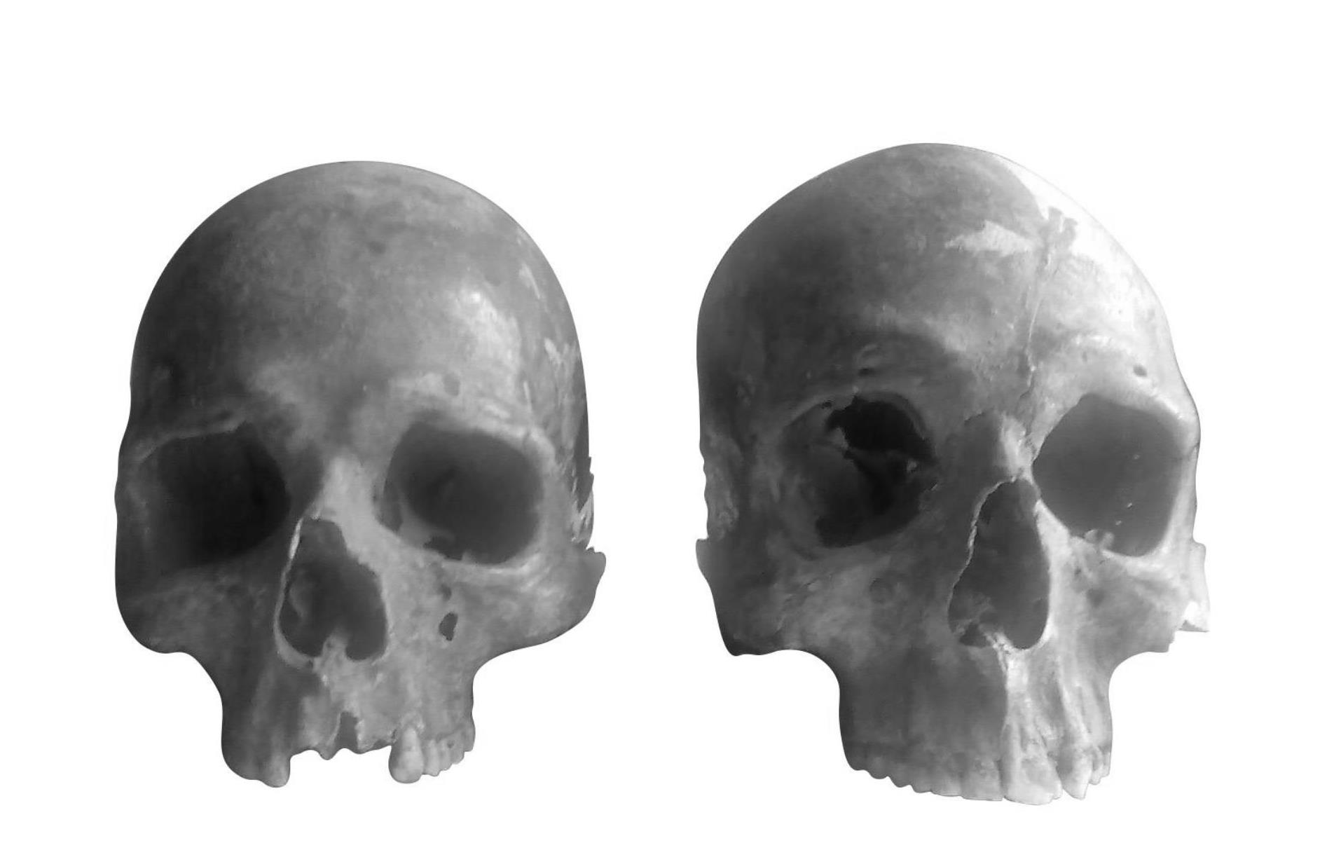
Sheki district

Slide 21
Janakhar necropolis
Khachmaz district

Slide 22
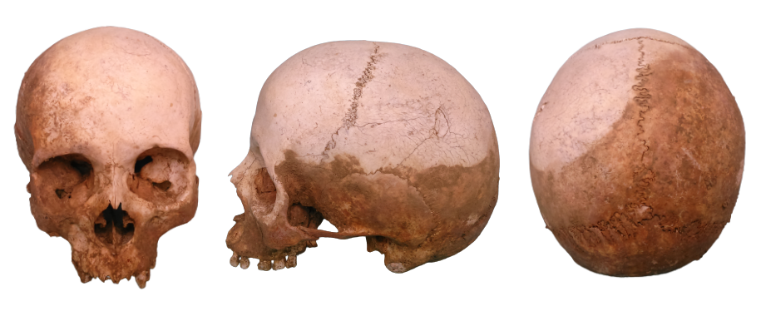
Alar necropolis
Yardymly district

Slide 23
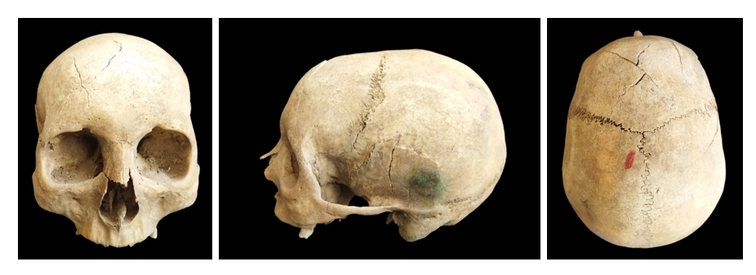
Skulls from jar burials
Khynysly necropolis
Shamakhi district

Slide 24
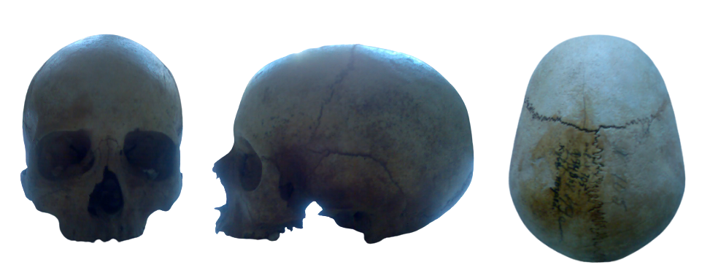
Mingachevir necropolis

Slide 25
Aminly necropolis masally district

Slide 26
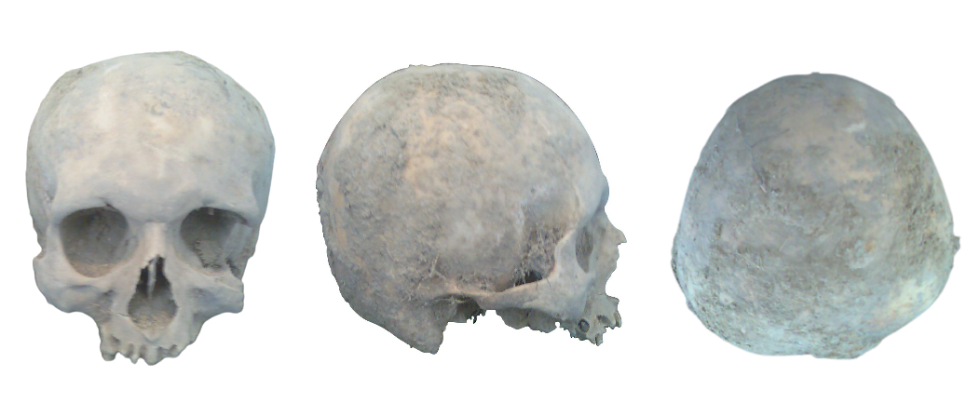
Shirvanly
Neftchala district

Slide 27
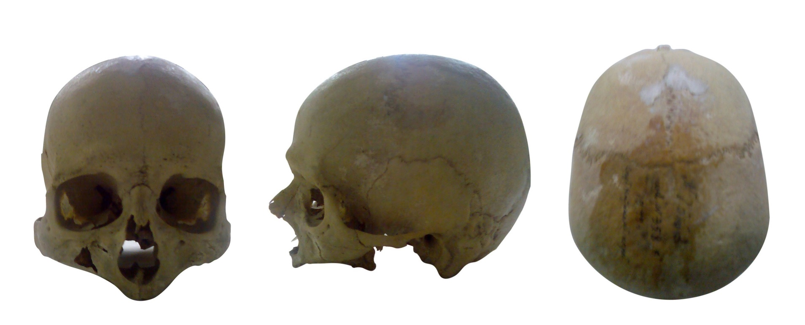
A skull from timber grave-catacomb

Slide 28
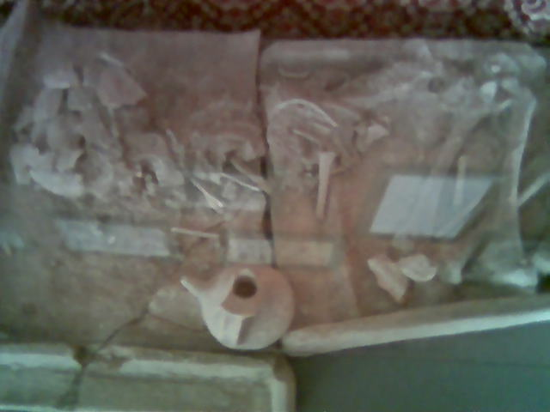
A Skull from burial in clay coffin

Slide 29
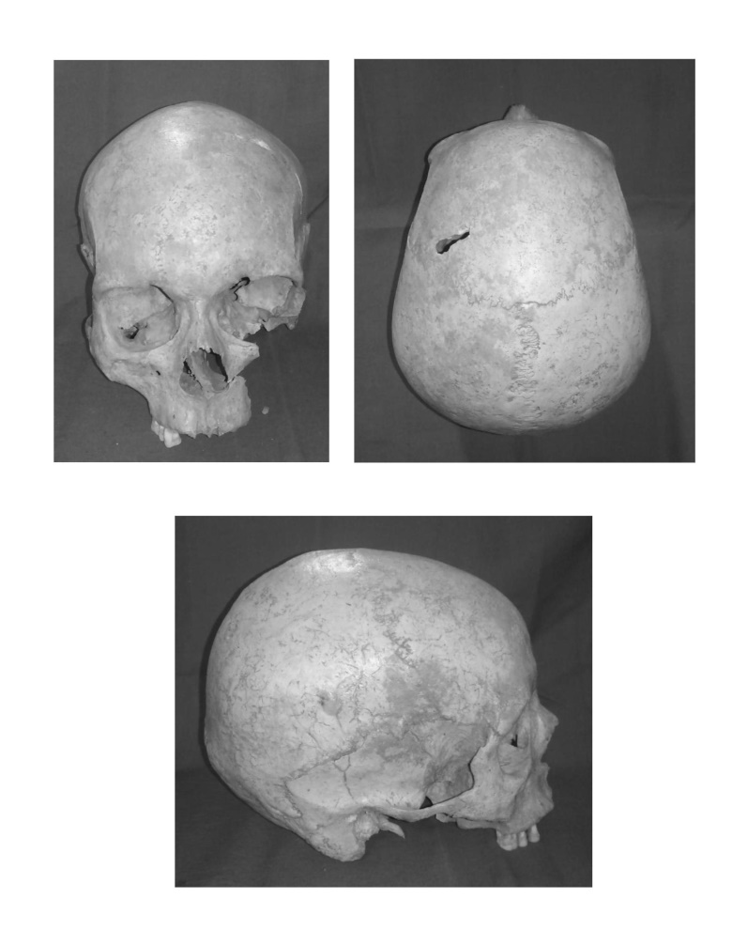
Skulls from stone boxes
Demirchi necropolis
Shamakhi district

Slide 30
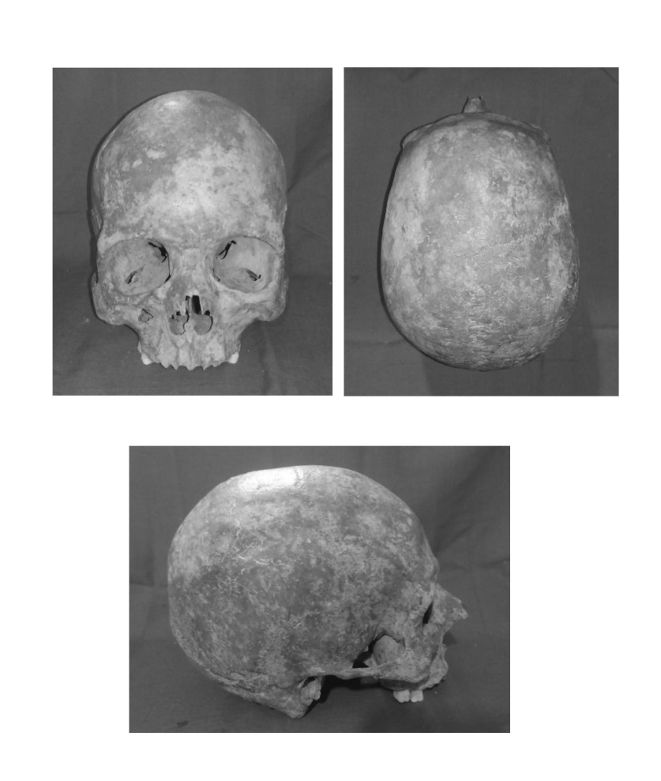

Slide 31
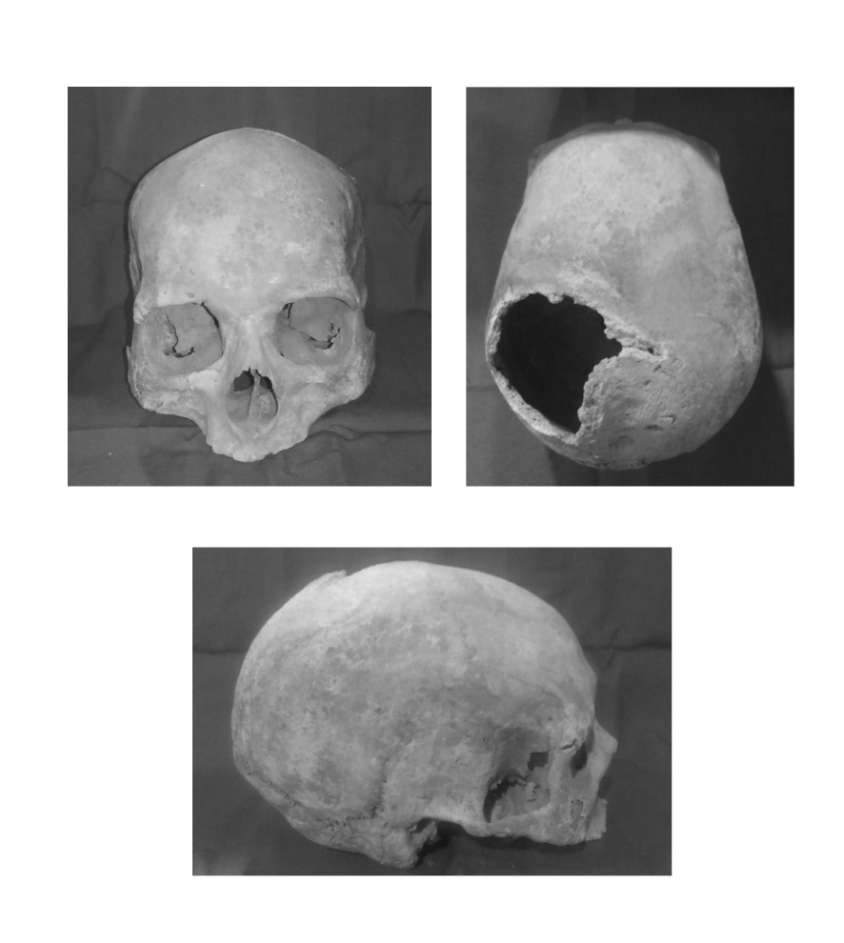

Slide 32
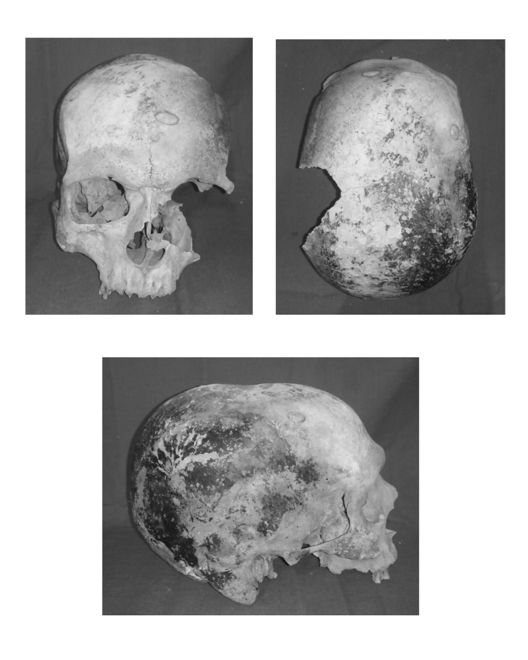

Slide 33
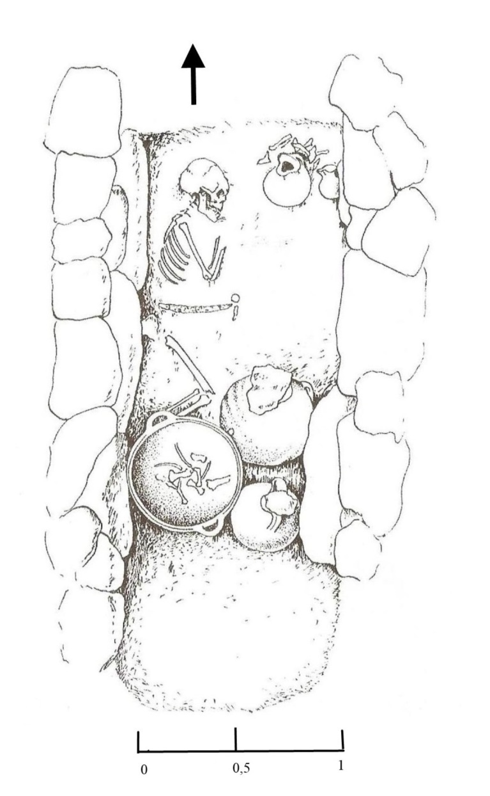

Slide 34
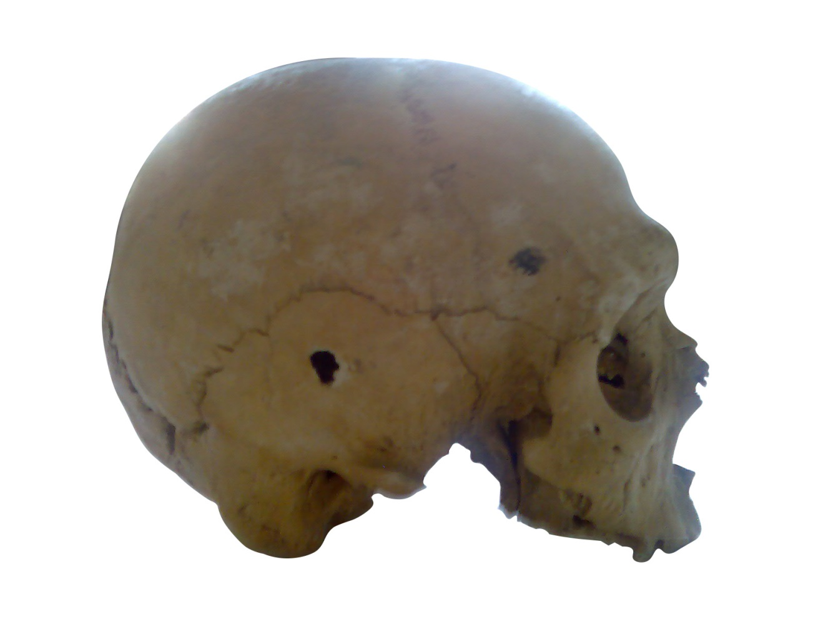
Skulls from catacomb burials
Mingachevir

Slide 35
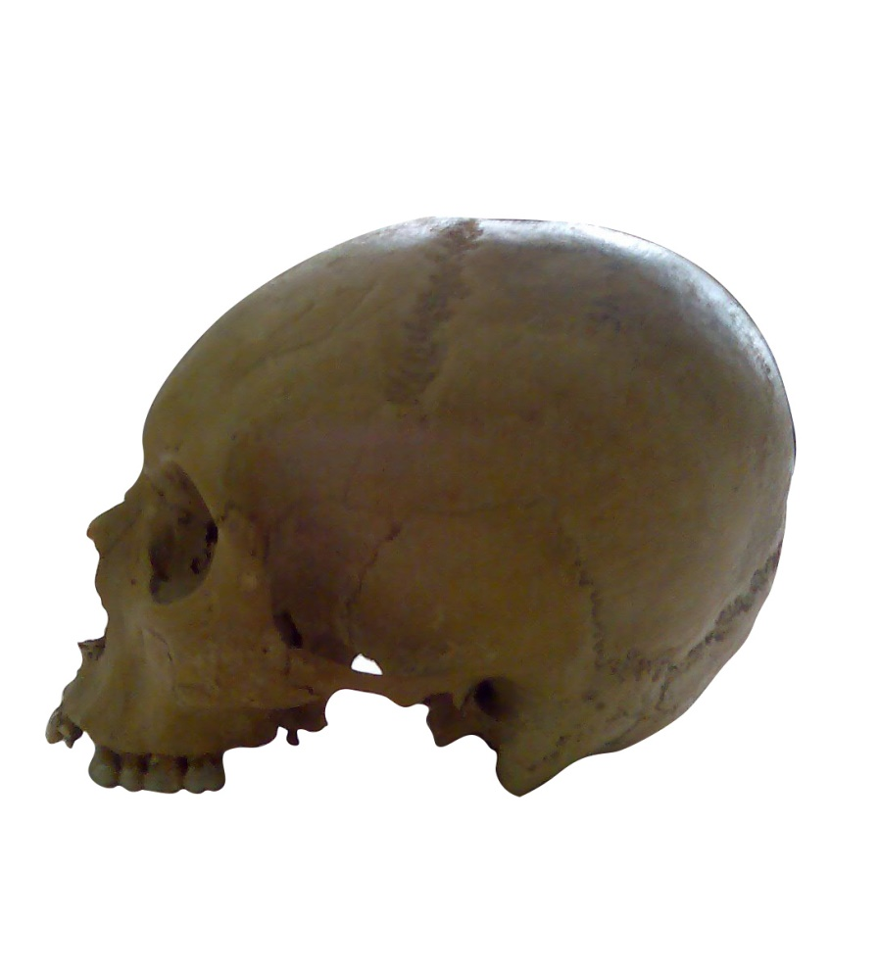
Artificial deformed skulls

Slide 36
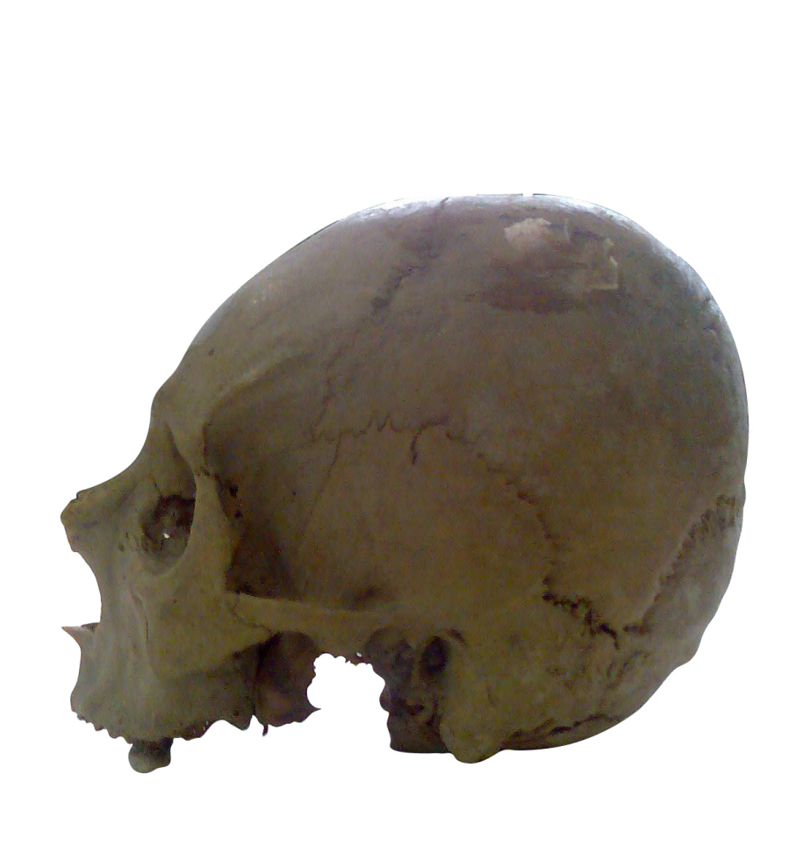

Slide 37
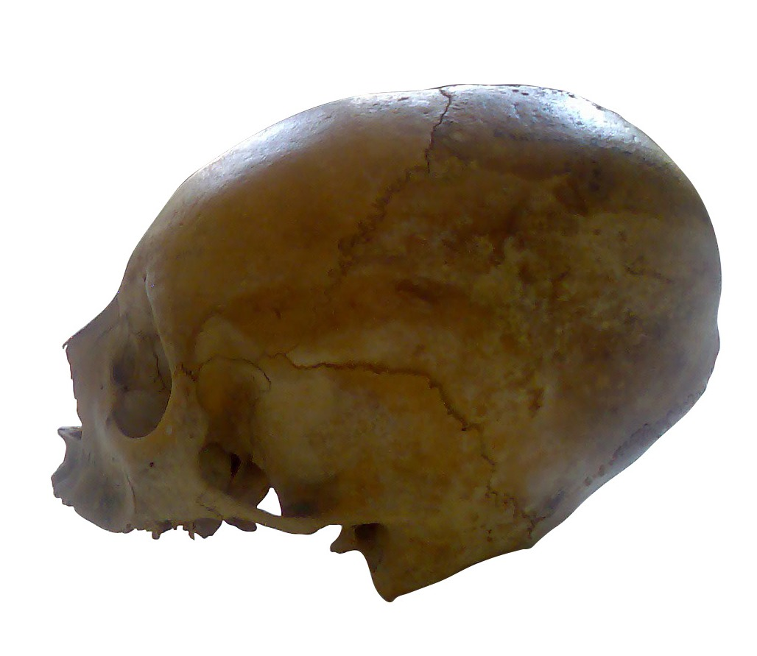

Slide 38
Kukhuroba
Gusar district

Slide 39
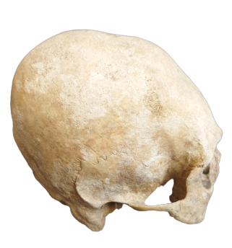
Gusar district

Slide 40
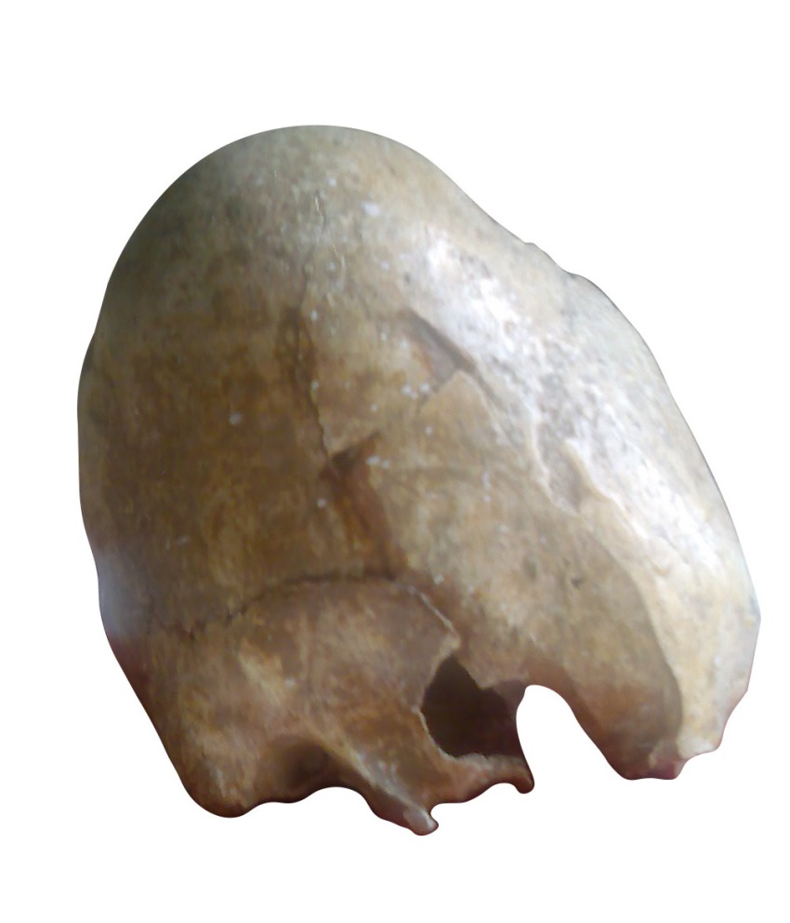
Sheki district

Slide 41
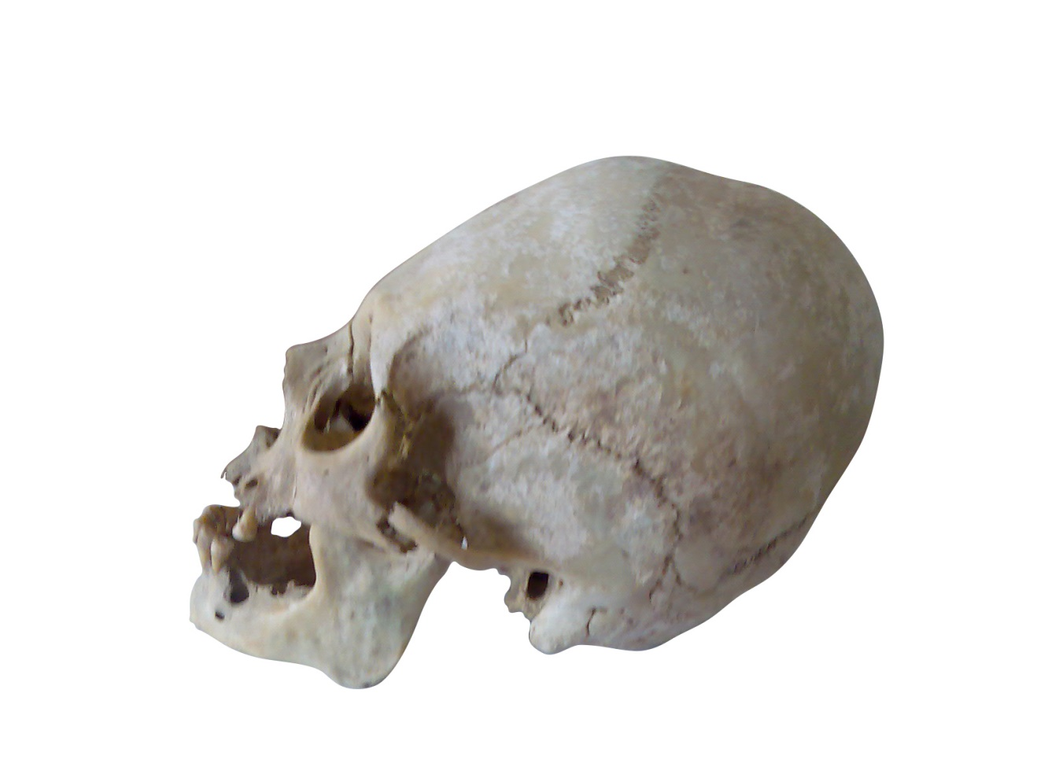
Skulls from soil graves with skeleton in extended position
Gijanoba
Guba district

Slide 42
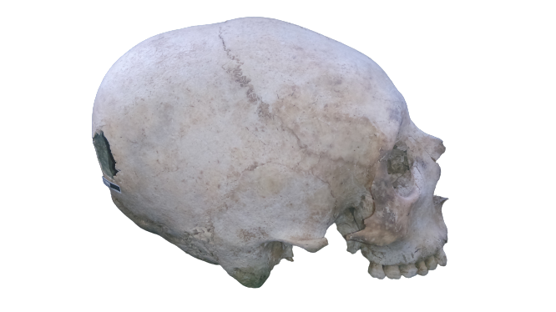
Sandygtepe V
Gusar district

Slide 43
anthropological materials from burials
Predominance of the Caspian anthropological type throughout the territory of our homeland.
The Caspian anthropological type has been represented on the territory of Azerbaijan in all historical periods, from the Mesolithic to the present.
Paleoanthropological materials confirm the findings of archaeologists that, despite the differences in the types of burials, more of them belonged to the autochthonous population of Azerbaijan.

Slide 44
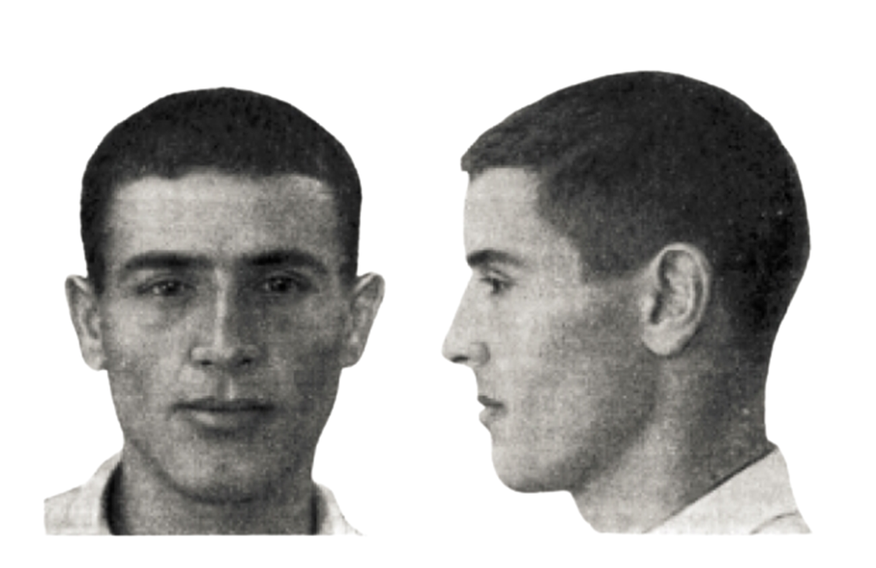
Caspian anthropological type

Slide 45
Types of traumas
Antemortem: An injury that occurs before death with evidence of healing (reformed bone with round, smooth edges)
Perimortem: An injury that occurs at or around the time of death when bone is still green or fresh (sharp, clean edges), with no evidence of healing
Postmortem: An injury that occurs after death, when bone is dry and brittle (jagged edges, random pattern), with no evidence of healing

Slide 46
Types of injuries depending on the Trauma Mechanism
Blunt-Force Injuries
Sharp-Force Injuries
Penetrative Injuries
Ballistic Injuries

Slide 47
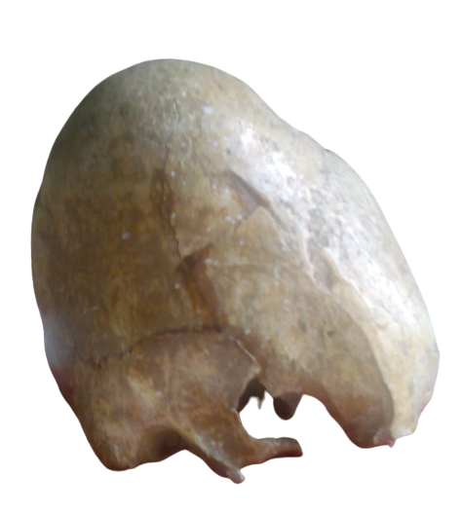
Shaki, catacomb burial, Postmortem

Slide 48
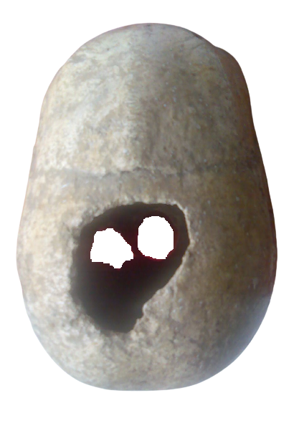

Slide 49
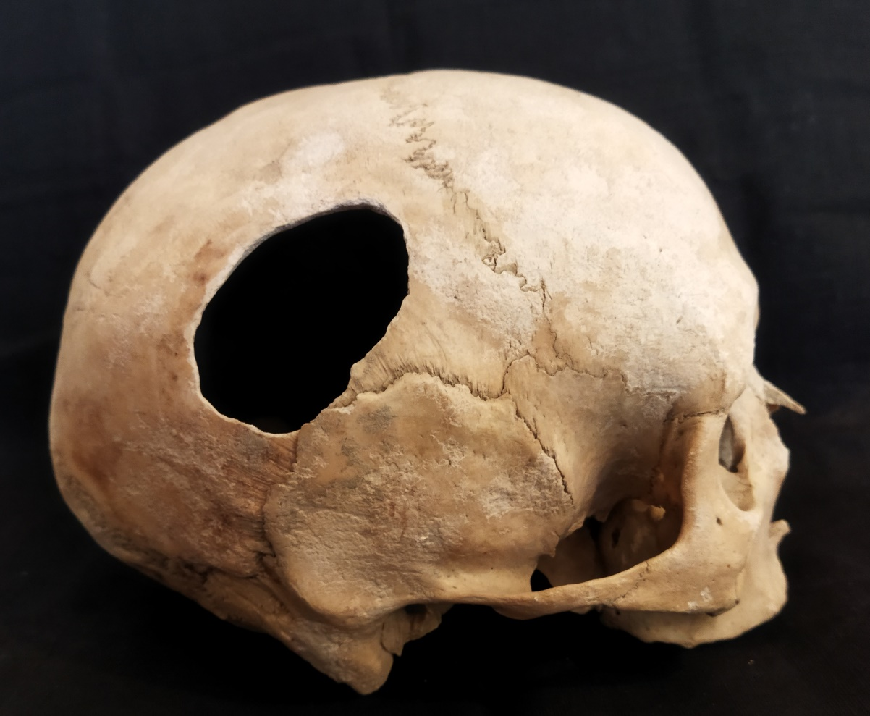
Catacomb burials from mingachevir, postmortem

Slide 50
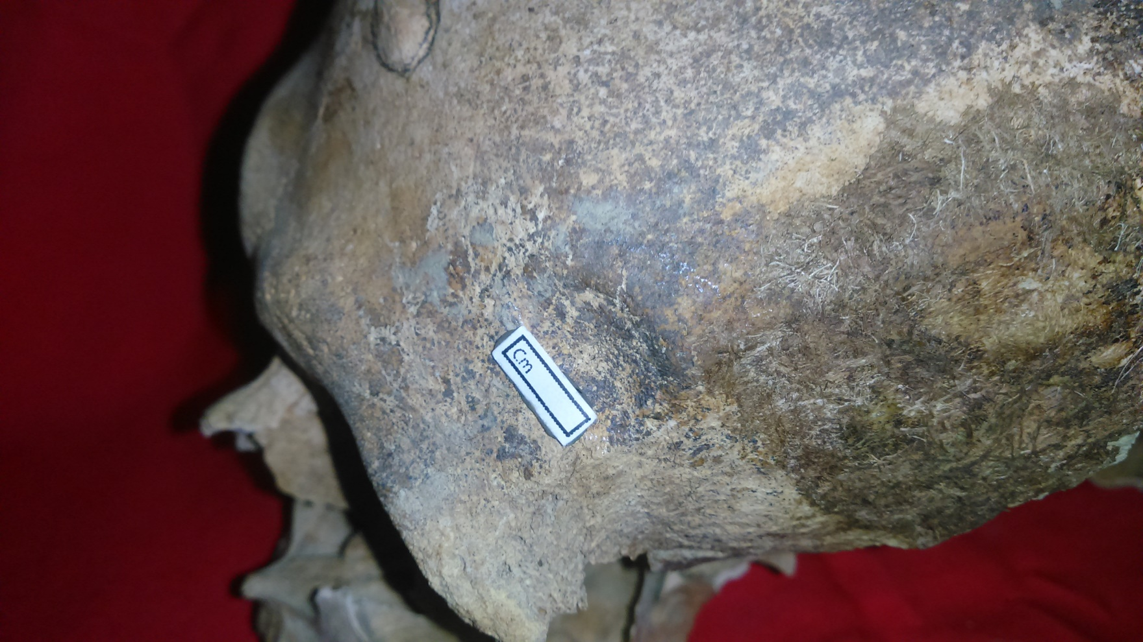
Demirchi necropolis, Burial 10, perimortem, blunt-force

Slide 51
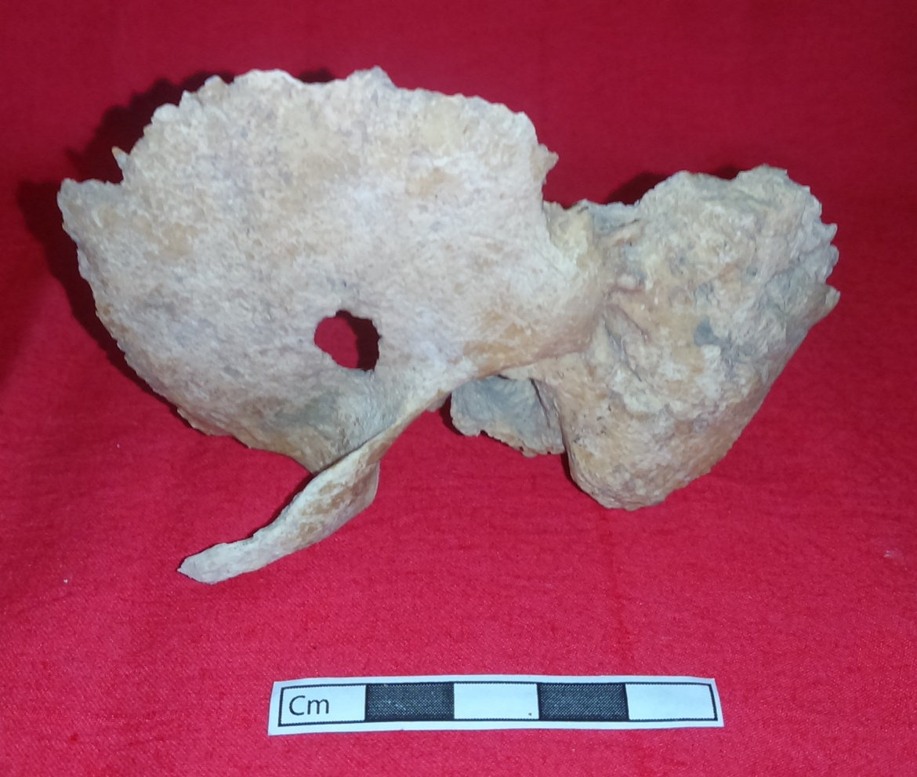
Demirchi necropolis, burial 11, perimortem

Slide 52
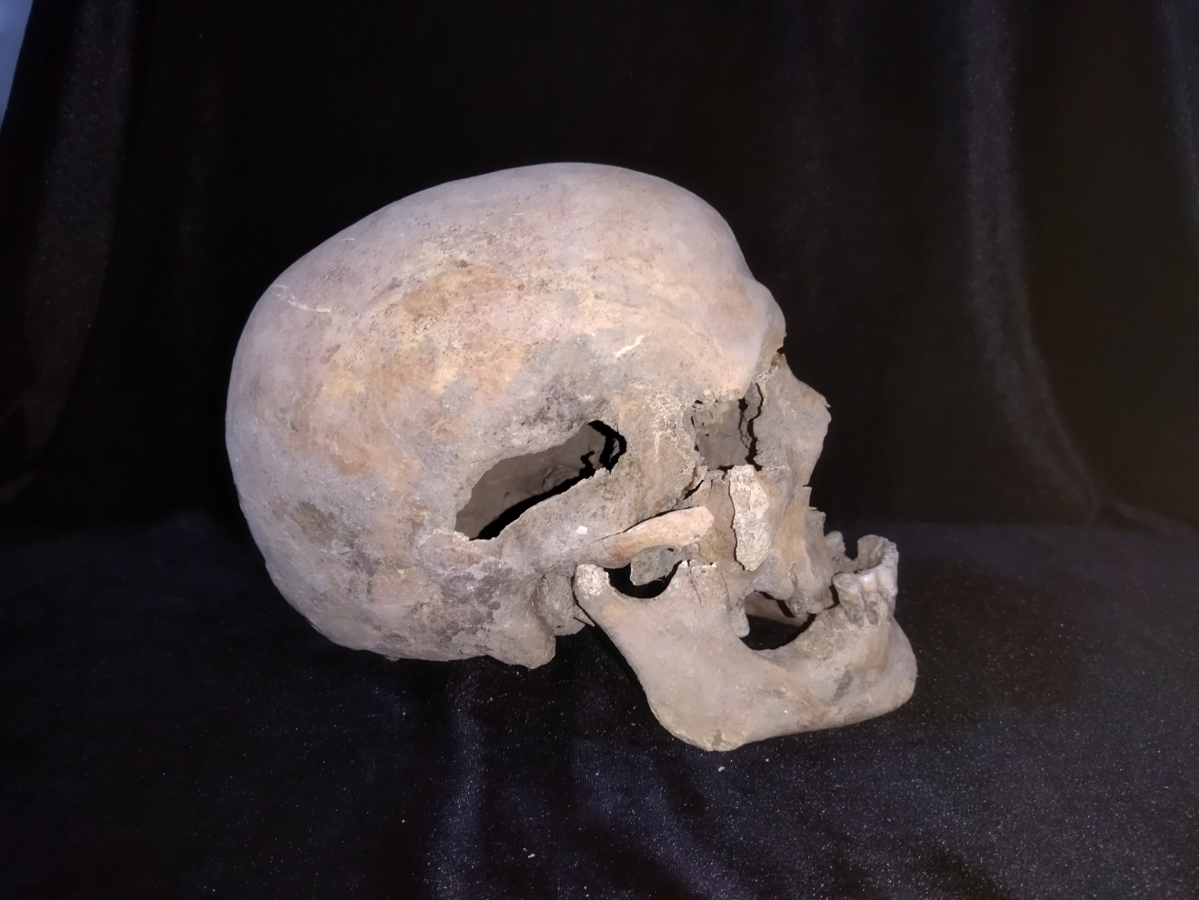
Aminly, jar burial, perimortem, sharp-force

Slide 53
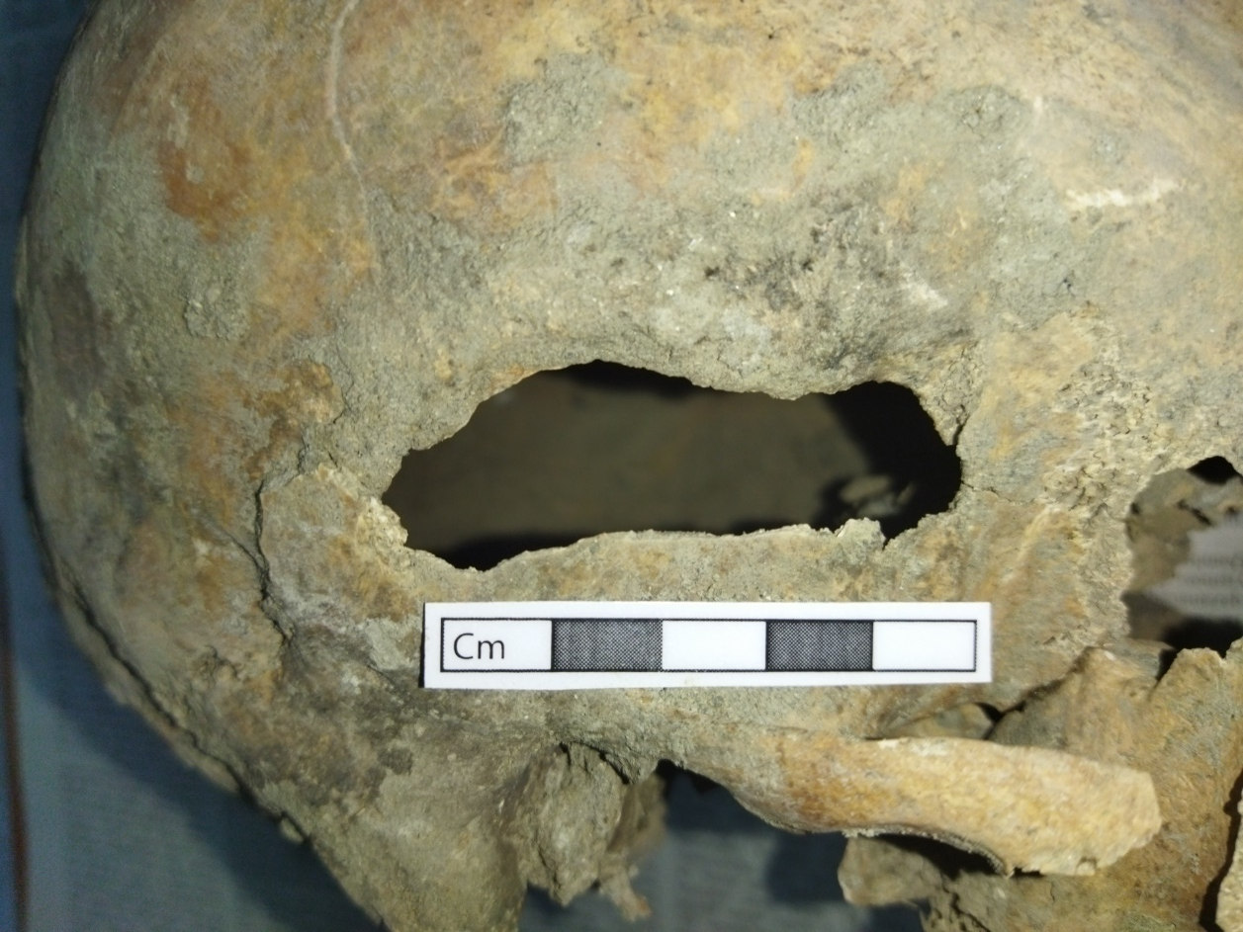

Slide 54
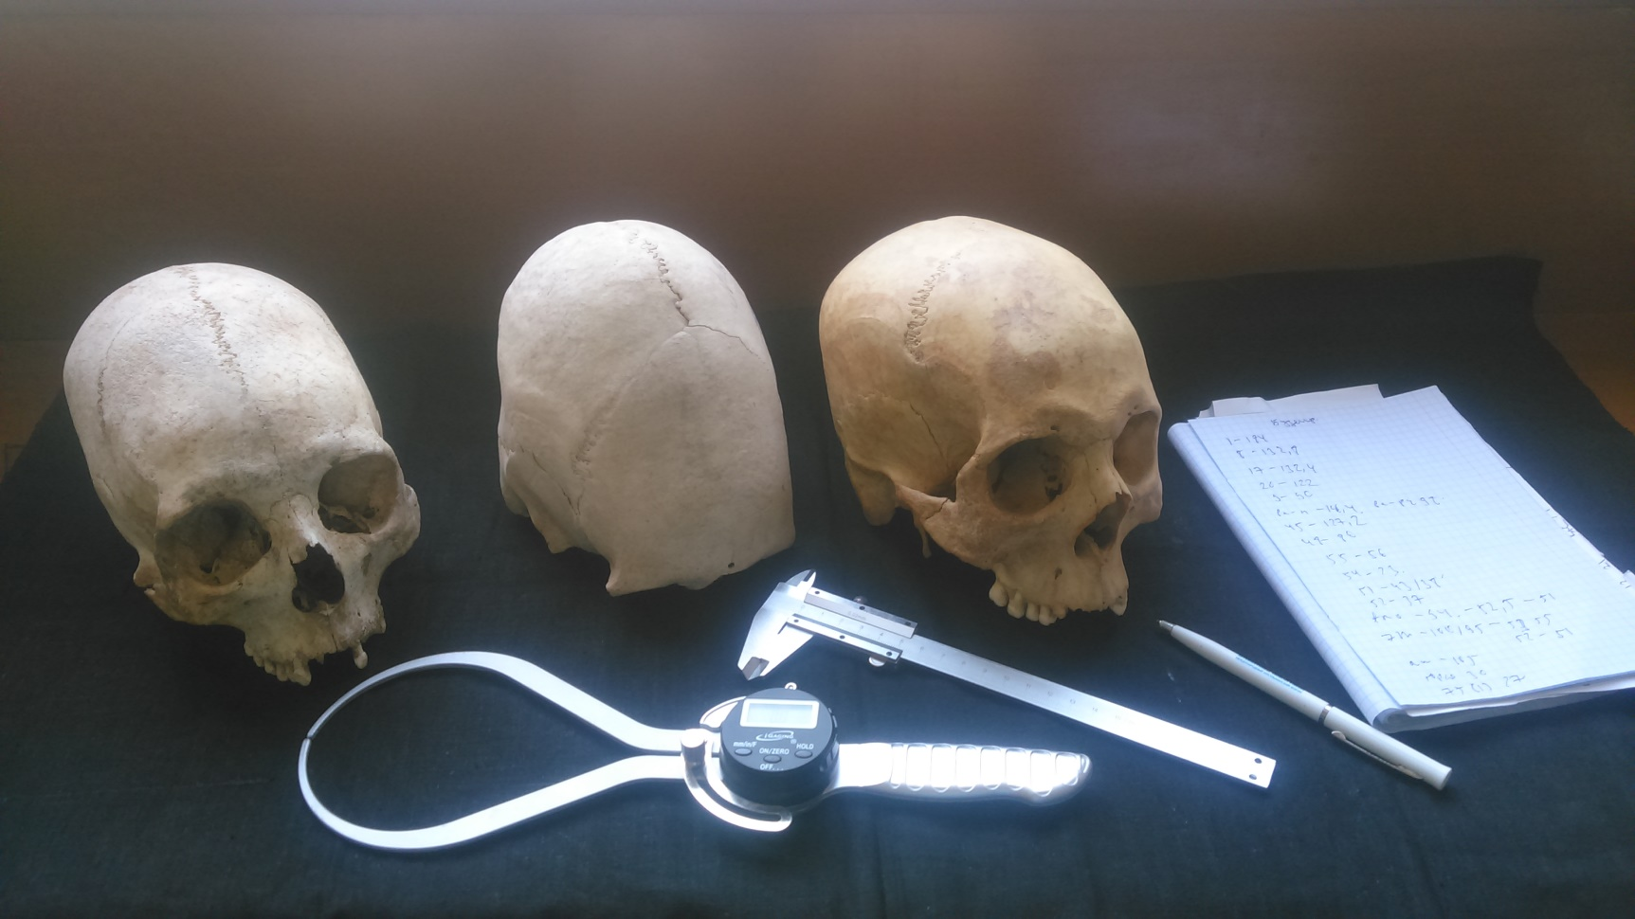
Thank you for attention !!!

