Slide 1
“Lenin, Putin and separatism in Georgia – the century long problem of so called
South Ossetia”
David Bragvadze
PhD-c
Interdisciplinary Summer School
“Explore Caucasus: at the Crossroad of Empires

Slide 2
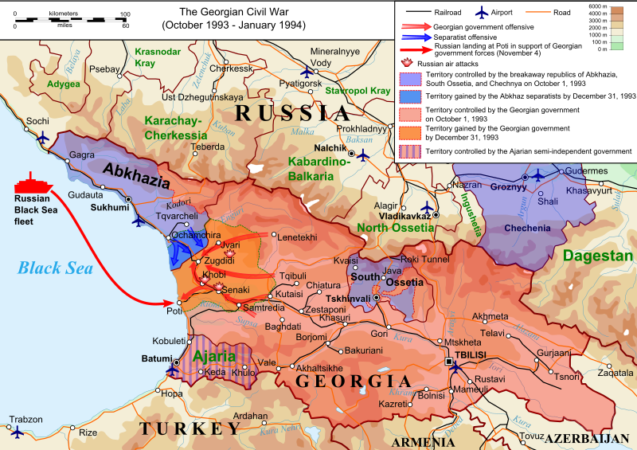

Slide 3
February – March, 1921 – Bolshevik Invasion
April, 1922 – South Ossetian Autonomous Oblast
December, 1936 – North Ossetian Autonomous Republic

Slide 5
1988 - The South Ossetian Popular Front (Ademon Nykhas) was established
10 November 1989 - the South Ossetian regional council asked the Georgian Supreme Council
to upgrade the region to the status of an Autonomous Republic
11 November, 1989 - this decision was revoked by the Georgian Supreme Soviet
July 1990 - The Georgian Supreme Soviet adopted a law barring regional parties
September 1990 - The South Ossetian regional council passed a "declaration of national sovereignty",
proclaiming the South Ossetian Soviet Democratic Republic within the Soviet Union
October 1990, the parliamentary election in Georgia was won by Zviad Gamsakhurdia’s "Round Table" block
On 11 December 1990, Zviad Gamsakhurdia's government abolished South Ossetia's autonomous status

Slide 6
22 December, 1991 – a coup d'état started in Tbilisi
6 January, 1992 - Gamsakhurdia and several of his supporters fled the city for exile.
The Military Council was created
19 January, 1992 - An Independence Referendum was held in South Ossetia
March 1992 – The Military Council invited Eduard Shevardnadze.
After his arrival the State Council was created
24 June 1992, Shevardnadze and the South Ossetian government signed
the Sochi ceasefire agreement brokered by Russia.

Slide 7
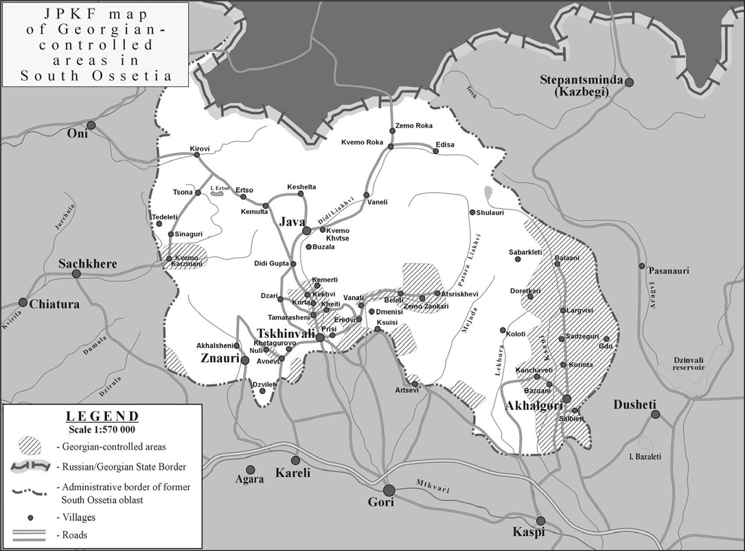

Slide 8
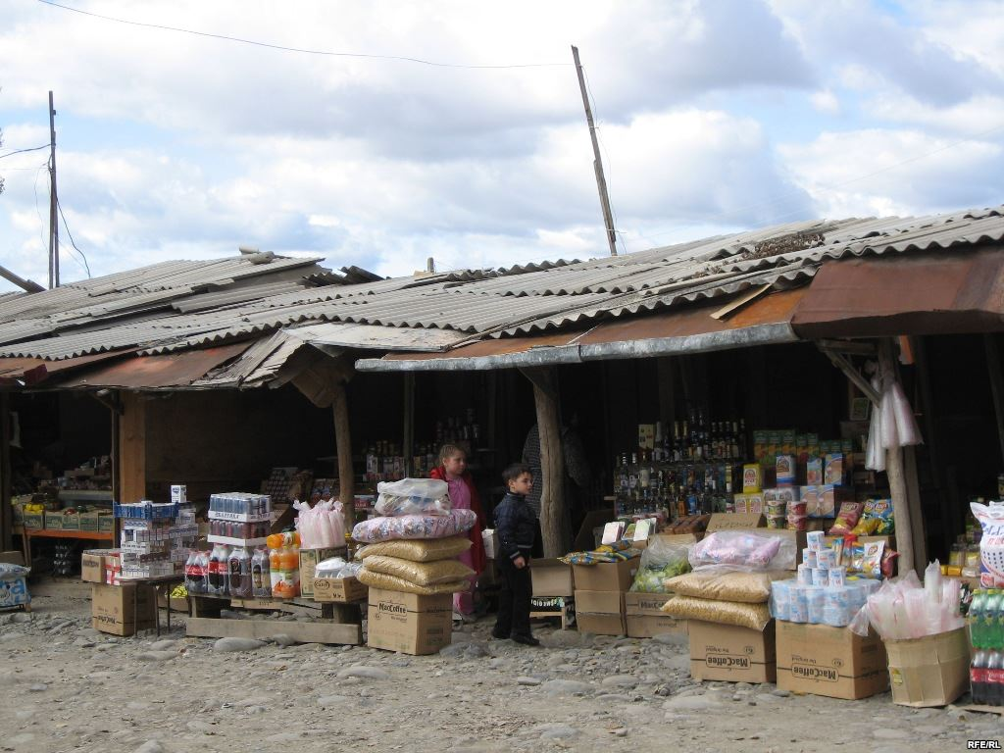
Ergneti Black Market

Slide 9
May 2004 - Closure of Ergneti Market
August 2004 Escalation
April 2007 – Temporary Administration of former South Ossetian AO was Created

Slide 10
August 7, 2008 – Russian Military aggression against Georgia
August 12, 2008 – Ceasefire Agreement brokered by EU signed

Slide 13
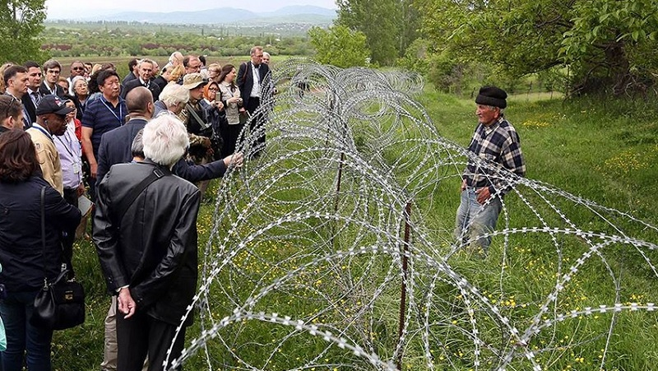
After 2008

Slide 14
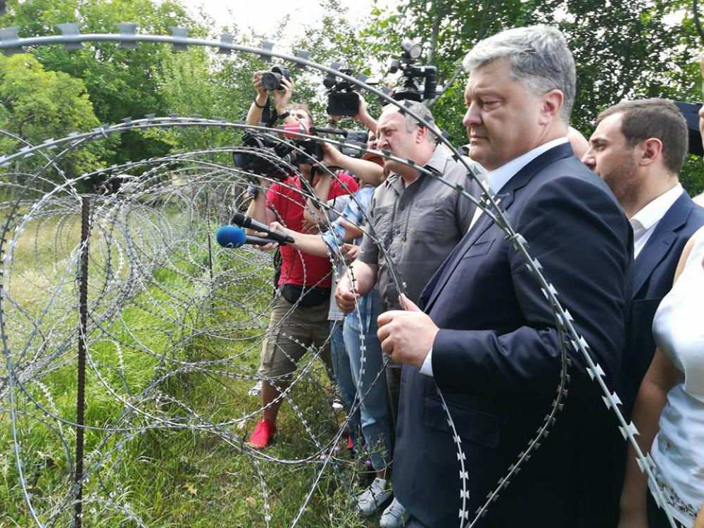

Slide 16
Joining Russia?
30 March 2022, President Anatoly Bibilov announced his intention to begin legal proceedings
in the near future to integration with the Russian Federation

